Slide 1
Employee Salary Prediction
CAPSTONE PROJECT
Presented By:
1. Anil Sabhajeet Yadav – Shree L.R Tiwari College of Engineering – Electronic and Telecommunication Engineering

Slide 2
OUTLINE
Problem Statement
System Development Approach
Algorithm & Deployment
Result
Conclusion
Future Scope
References

Slide 3
Problem Statement
Companies face difficulty in determining fair salaries for employees across diverse roles and backgrounds.
Manual salary decisions often lead to bias, inconsistency, and inefficiency.
There's no standard approach to predict salary based on employee data.
HR teams need help to analyze large datasets quickly and accurately.
This creates challenges in workforce planning and cost management.

Slide 4
System Approach
Library required to build the model
Data Handling & Preprocessing:
pandas, numpy, LabelEncoder, OneHotEncoder, StandardScaler
Model Building:
LogisticRegression, RandomForestClassifier, GradientBoostingClassifier, KNeighborsClassifier, SVC
Model Evaluation & Utility:
train_test_split, accuracy_score, classification_report, Pipeline
Model Saving:
joblib
User Interface:
streamlit, gradio
Visualization:
matplotlib.pyplot
System Requirements
Platform: Jupyter Notebook
Language: Python 3.x
Deployment Tools: Streamlit, Gradio
Output: Web-based salary prediction interface

Slide 5
Algorithm & Deployment
Step 7: Evaluate each model using accuracy_score and classification_report.
Step 8: Select the best-performing model based on accuracy.
Step 9: Save the trained model using joblib.
Step 10: Build a front-end interface using Gradio to accept user inputs.
Step 11: Connect the interface with the model to return live predictions.
Step 12: Share the web app via the Gradio public link for real-time access.
Step 1: Import necessary libraries like pandas, sklearn, matplotlib, gradio, etc.
Step 2: Load the dataset and clean missing or invalid values using pandas.
Step 3: Encode categorical columns using LabelEncoder or OneHotEncoder.
Step 4: Normalize numerical features using StandardScaler.
Step 5: Split the dataset into training and testing sets using train_test_split.
Step 6: Train multiple machine learning models:
LogisticRegression
RandomForestClassifier
GradientBoostingClassifier
KNeighborsClassifier
SVC

Slide 6
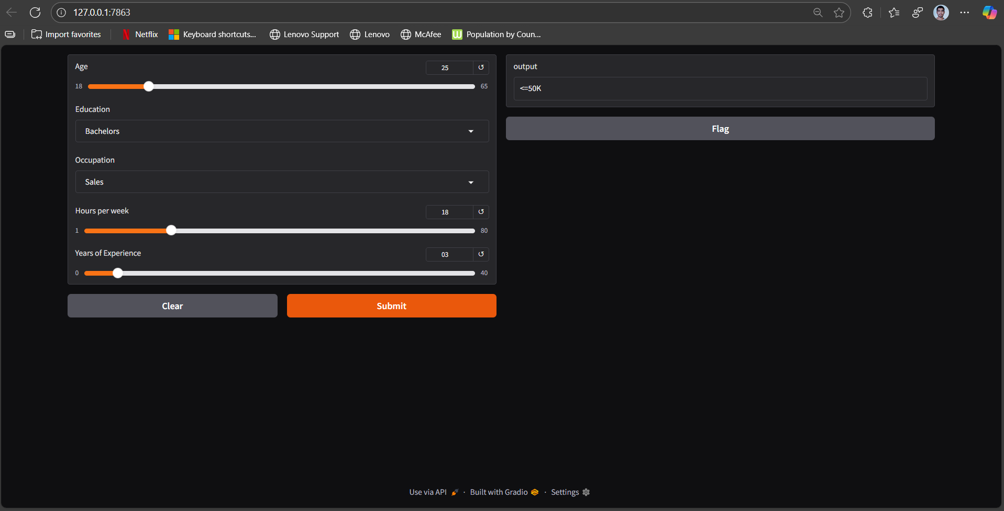
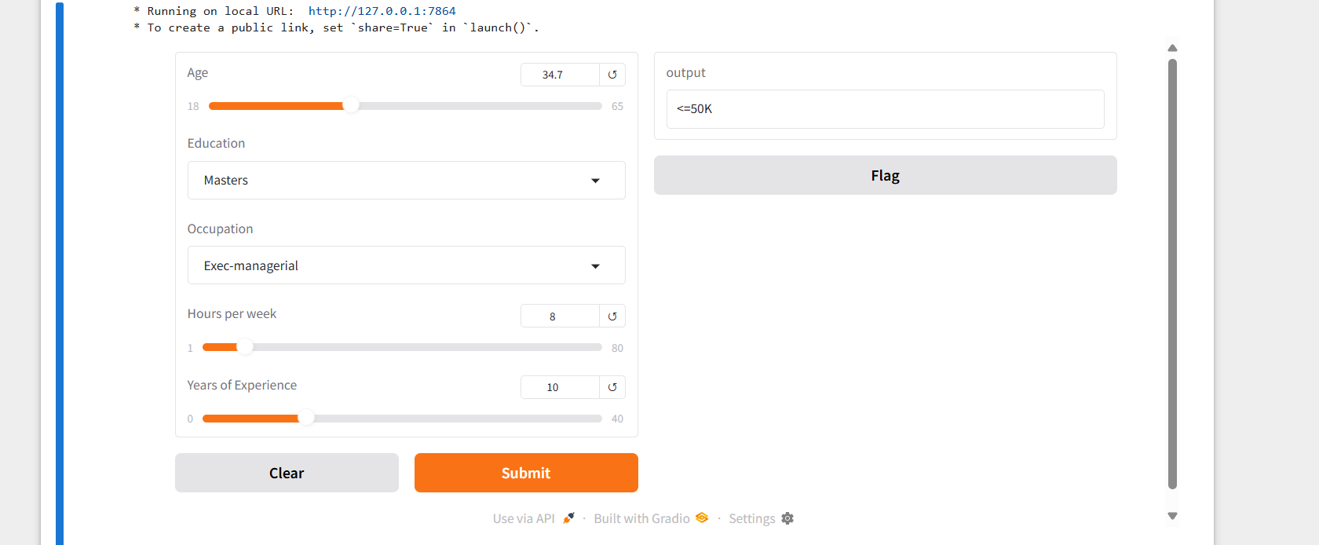
Result
Result:-
Attach your Github link
https://github.com/Anilsgyadav/Employee-Salary-Prediction.git

Slide 7
Conclusion
This project effectively demonstrates how machine learning can be used to predict whether an employee earns more than $50K based on demographic and work-related attributes. After experimenting with multiple algorithms, the Random Forest Classifier delivered the best performance in terms of accuracy. A simple and user-friendly web interface was developed using Gradio, enabling real-time predictions. Despite some challenges in handling categorical variables and model tuning, the overall system proved to be reliable, efficient, and practical for real-world HR analytics.

Slide 8
References
Barry Becker ,UCI Machine Learning Repository: Adult Dataset,University of California, Irvine.,https://archive.ics.uci.edu/ml/datasets/adult, 1996
Pedregosa, Scikit-learn: Machine Learning in Python, Journal of Machine Learning Research, vol. 12, pp. 2825–2830.,https://scikit-learn.org, 2011
Abid,Chetty,Bisong, Gradio: Simplifying Machine Learning Interfaces , Gradio Official Documentation., https://gradio.app, 2021
euralNine, Income Prediction Machine Learning Project in Python, YouTube.com, https://www.youtube.com/watch?v=RI8yBHJSfSw, 2023
Sanhiitaa (GitHub User), Employee Salary Prediction using Machine Learning, GitHub Repository., https://github.com/sanhiitaa/salary-prediction, 2022
OpenAI Contributors, Joblib Documentation – Model Serialization for Python, https://joblib.readthedocs.io, Ongoing
Matplotlib Developers ,Matplotlib: Python Plotting Library, https://matplotlib.org, 2003–Present

Slide 9
THANK YOU

